Slide 1
The core concepts of physiology:
What are they and what role can they play in designing a physiology curriculum?
Joel Michael, PhD
Department of Physiology
Rush Medical College
Chicago, IL

Slide 2
Acknowledgements

Slide 3
Acknowledgements
THE CAP TEAM
Joel Michael
Jenny McFarland
Harold Modell
Mary Pat Wenderoth
Bill Cliff
Ann Wright

Slide 4
Acknowledgements
THE CAP TEAM
Joel Michael
Jenny McFarland
Harold Modell
Mary Pat Wenderoth
Bill Cliff
Ann Wright
National Science Foundation

Slide 5
Core concepts of physiology
My colleagues and I have been thinking about the issue of core concepts in physiology for a number of years. We believe that a focus on core concepts can be used to address two of the questions I posed yesterday morning: (1) what is the core content for a physiology major, and (2) and how do we sequence that content.

Slide 6
Agenda for this morning

Slide 7
Agenda for this morning
(1) Describe the core concepts of physiology

Slide 8
Agenda for this morning
(1) Describe the core concepts of physiology
(2) Describe how attention to the core concepts can help solve the problem of defining the content of a physiology major

Slide 9
Agenda for this morning
(1) Describe the core concepts of physiology
(2) Describe how attention to the core concepts can help solve the problem of defining the content of a physiology major
(3) Describe how attention to the core concepts can contribute to the creation of an appropriate sequence of educational experiences

Slide 10
What is a core concept?
“Core concept” and “big idea”
are essentially synonymous.

Slide 11
What is a core concept?
[A core concept is an idea that is] “well tested, validated, and absolutely central to the discipline. Each integrates many different findings and has exceptionally broad explanatory scope. Each is the source of coherence for many key concepts, principles, and even other theories in the discipline.”
Duschl RA, Schweingruber HA, Shouse AW (eds). Taking science to school: Learning and teaching science in grades K-8. National Academies Press, Washington DC

Slide 12
For me personally . . .

Slide 13
For me personally . . .
a core concept is what I want my students to remember in five years even if they remember none of the details!

Slide 14
How did we develop the core concepts of physiology?
Conceptual assessment in biology meeting (2007)
Deliberations on core concepts of physiology (2007-2008)
Surveys of physiology teaching faculty (2008-2010)
Discussions and workshops at APS and HAPS meetings (2007-2010)

Slide 15
The core concepts of physiology
(alphabetical order)
Causality | Homeostasis
Cell-cell communication | Interdependence
Cell membrane | Levels of organization
Cell theory | Mass balance
Energy | Physics/chemistry
Evolution | Scientific reasoning
Flow down gradients | Structure/function
Genes to proteins

Slide 16
The core concepts . . .
Are NOT an attempt to systematically define the science of physiology
DO NOT define the content of a physiology course
DO NOT define the content of a physiology curriculum
The list is not unique and not definitive
Our goal has always been pragmatic and utilitarian; what will help teaching/learning

Slide 17
The core concepts . . .
Are a tool that faculty can use in designing and teaching a physiology course
Are a tool which faculty can use in designing a curriculum
Are, not incidentally, a tool to be used by students in their attempt to master physiology

Slide 18
BIOLOGY (CAB mtg) | BIOLOGY (Vision & Change) | PHYSIOLOGY (Michael etal)
Ecosystems
Evolution | Evolution | Evolution
Homeostasis |  | Homeostasis
Information flow | Information flow
Causality |  | Causality
Matter/energy | Matter/energy | Energy
Structure/function | Structure/function | Structure/function
The cell |  | Cell theory
 | Systems | Levels of organization
 |  | Cell-cell communication
 |  | Cell membrane
 |  | Flow down gradients
 |  | Genes to proteins
 |  | Interdependence
 |  | Mass balance
 | Scientific reasoning | Physics/chemistry

Slide 19
BIOLOGY (CAB mtg) | BIOLOGY (Vision & Change) | PHYSIOLOGY (Michael etal)
Ecosystems
Evolution | Evolution | Evolution
Homeostasis |  | Homeostasis
Information flow | Information flow
Causality |  | Causality
Matter/energy | Matter/energy | Energy
Structure/function | Structure/function | Structure/function
The cell |  | Cell theory
 | Systems | Levels of organization
Common to BIOLOGY |  | Cell-cell communication
and PHYSIOLOGY |  | Cell membrane
 |  | Flow down gradients
 |  | Genes to proteins
 |  | Interdependence
 |  | Mass balance
 | Scientific reasoning | Physics/chemistry

Slide 20
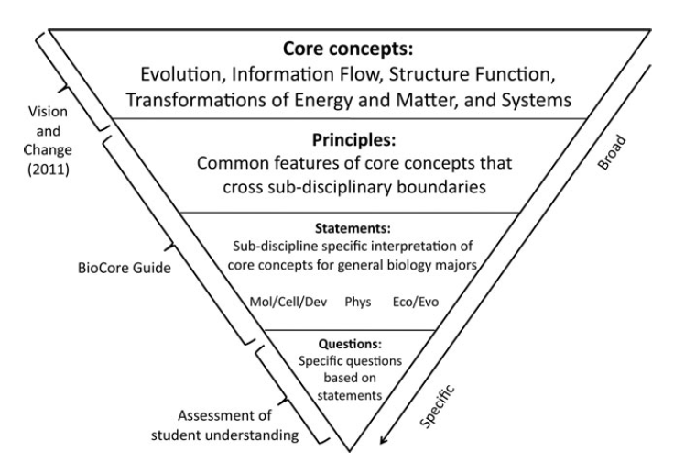
Brownell, Freeman, Wenderoth, and Crowe, 2014

Slide 21
Validating the core concepts
Once we had a list of core concepts, we went back to the physiology teaching community and asked them to identify what they thought were the most important concepts.

Slide 22
The core concepts of physiology
(rank order)
Cell membrane (1) | Cell theory (9)
Homeostasis (1) | Physics/chemistry (10)
Cell-cell communic.(3) | Genes to proteins (11)
Interdependence (4) | Levels of organiz. (12)
Flow down gradients(5) | Mass balance (13)
Energy (6) | Causality (14)
Structure/function (7) | Evolution (15)
Scientific reasoning (8)

Slide 23
The core concepts of physiology
(rank order)
Cell membrane (1) | Cell theory (9)
Homeostasis (1) | Physics/chemistry (10)
Cell-cell communic.(3) | Genes to proteins (11)
Interdependence (4) | Levels of organiz. (12)
Flow down gradients(5) | Mass balance (13)
Energy (6) | Causality (14)
Structure/function (7) | Evolution (15)
Scientific reasoning (8)

Slide 24
Three Core Concepts of Physiology
(see handout)
Cell-cell communications: The function of the organism requires that cells pass information to one another to coordinate their activities. These communications processes include endocrine and neural signaling. This concept describes the mechanism by which cells pass information to one another, thus making possible the coordinated activity of all of the cells of the body.
Flow down gradients: The transport of “stuff” (ions, molecules, blood, and gas) is a central process at all levels of organization in the organism, and a simple model describes such transport. Ions crossing a cell membrane, blood flowing in blood vessels, gas moving in airways, and chyme moving down the gastrointestinal tract are all processes that result from the interaction of an energy gradient and the resistance to flow that is present.
Homeostasis: The internal environment of the organism is actively maintained constant by the function of cells, tissues, and organs organized into negative feedback systems. The role of negative feedback in regulating the functions of the body is a particularly powerful core concept in that it describes so much of organ system physiology.

Slide 25
What does a conceptual framework look like?

Slide 26
What does a conceptual framework look like?
Level | Example
CORE CONCEPT (BIG IDEA) | CELL-CELL COMMUNICATION
Critical components | CC4 binding of the messenger molecule to its receptor gives rise to signal transduction
Constituent ideas | CC4.3 there are two basic mechanisms for transduction . . .
Elaborations | CC4.3.3 The speed of response of the two systems is different
Amplifications | CC4.3.3.1 The speed of response in a second messenger system is fast

Slide 27
The flow down gradients conceptual framework
F1. Flow is the movement of “substance” from one point in the
system to another point in the system.
F1.1 Molecules and ions can diffuse through a solution.
F1.2 Fluid (blood, chyme) and gases (air) are transported
through tubes.
F1.3 Heat can move through objects.
F2. Flow occurs because of the existence of an energy
gradient between two points
F2.1 Differences in concentration (concentration
gradients) cause molecules and ions in solution to
move down a gradient from high to low
concentration.
See handout

Slide 28
Which core concepts to use?
It is unlikely that any physiology course (or even a curriculum) will emphasize ALL 15 core concepts.
Which ones to use will clearly depend on the goals for your course or curriculum.
It seems to me that the top 4 or 5 are likely to be important in all courses.

Slide 29
Defining the content of a physiology major
If you are going to formalize a physiology undergraduate major you have to identify some common knowledge of physiology (even if the actual content or the amount is undefined).
A focus on the core concepts of physiology provides a means of identifying that common core.

Slide 30
Describing the sequence of experiences that makes up the major
A major implies that there is some sequence of experiences (courses?) that must be taken to qualify as a graduate of that major.
Again, attention to the core concepts provides a tool for determining what needs to be learned first and what can be learned later in the sequence.

Slide 31
Core concept | Intro | Intermed | Advanced
Homeostasis | Sensor (H3) Control Center (H4) Effector (H5) Negative feedback (H2.1) | Reg vs contr variable (H5.3) Integrator (H4.2, 4.3, 4.5) | Feedforward Allostasis Acclimatization
Flow down gradients | Flow Energy gradient Resistance | Determ of flow Multi energy grads Determ of resistance Control of resistance | 2nd active transp Solvent drag Ion selectivity Gating behavior Poiseuille’s Law Starling equation
Cell-cell Communica- tions | Messenger molecules Biochemistry Cell release Target cell Receptor binding Signal transduction Cell response | Determ of cell release Transport of mess. Moles Determ of receptor binding Determ of signal ampl Signal integration Determ of recell response Mech of signal termination

Slide 32
Using core concepts to shape the physiology curriculum
1. The core concepts and their CFs provide an explicit template for describing what needs to the mastered.
2. The CFs, with their hierarchical structure, make it possible to map the core concepts onto the courses making up the curriculum.
3. At the same time the hierarchical CFs can provide a kind of checklist for determining what your courses now cover.

Slide 33
Some caveats
The list of core concepts does not define the necessary content of any course
  A 300 or 400 level endocrine course will require a different physiology content than a course on the CV system
  A course for physical therapy students may have a different physiology content than a course for nursing students
  BUT THE CORE CONCEPTS ARE TOOLS TO BE USED IN TEACHING/LEARNING ALL OF THEM

Slide 34
Another problem
Old data about the size of physiology textbooks
(it only gets worse!)
Human A & P | Saladin, 2007 | 1248 pp
 | Marieb, 2007 | 1296 pp
 | Martini, 2007 | 1110 pp
Undergrad Physio | Sherwood, 2004 | 801 pp
 | Widmaier etal, 2004 | 738 pp
Medical Physio | Boron and Boulpaep, 2003 | 1267 pp
 | Berne et al, 2004 | 978 pp
 | Guyton and Hall, 2006 | 1066 pp

Slide 35


Slide 36
Core concepts: the book
(what it is and what it isn’t)
Michael, J, Cliff, C, McFarland, J, Modell, H, Wright, A. (2017). The core concepts of physiology: A new paradigm for teaching physiology. New York: Springer Nature.
This book contains NO prescription for a physiology course or a physiology curriculum (major).

Slide 37
Core concepts: the book
(what it is and what it isn’t)
It does attempt to provide a new framework (paradigm) for thinking about how to teach physiology.
It does attempt to describe how to most effectively incorporate core concepts in all aspects of your course.

Slide 38
Journal References
1. Michael, J., Modell, H., McFarland, J., and Cliff, W. (2009). The “core principles” of physiology: What should students understand? Adv Physiol Educ, 33: 10-15.DOI: 10.1152/advan.90139.2008
2. Michael, J. and McFarland, J. (2011) The core principles (“big ideas”) of physiology: Results of faculty surveys. Adv Physiol Educ 25: 336-341. DOI: 10.1152/advan.00004.2011
3. Modell, H., Cliff, W., Michael, J., McFarland, J, Wright, A. ,Wenderoth, M.P. (2015) A physiologist's view of homeostasis. Adv Physiol Educ 39(4): 259-266.DOI: 10.1152/advan.00107.2015
4. McFarland, J, Michael, J., Modell, H., Wenderoth, M.P., Cliff, W., Wright, A. (2016) A conceptual framework for homeostasis: Development and validation. Adv Physiol Educ 40: 213–222.
DOI: 10.1152/advan.00103.2015
5. McFarland, JL, Price, RM, Wenderoth, MP, Martinková, P, Cliff, W, Michael, J,
Modell, H, Wright, A. Development and validation of the homeostasis concept
Inventory. (Accepted for publication in CBE-Life Sci Educ)
6. Michael, J, Martinkova, P, McFarland, L, Wright, A, Cliff, W, Modell, H.
Validating a conceptual framework for the core concept of cell-cell
communication. (Accepted for publication in Adv Physiol Educ)

Slide 40
What follows?
After some Q and A there will be a discussion session during which we will be asking you to do the talking. We want to know what you think the important core concepts might be for a physiology major.

Slide 42
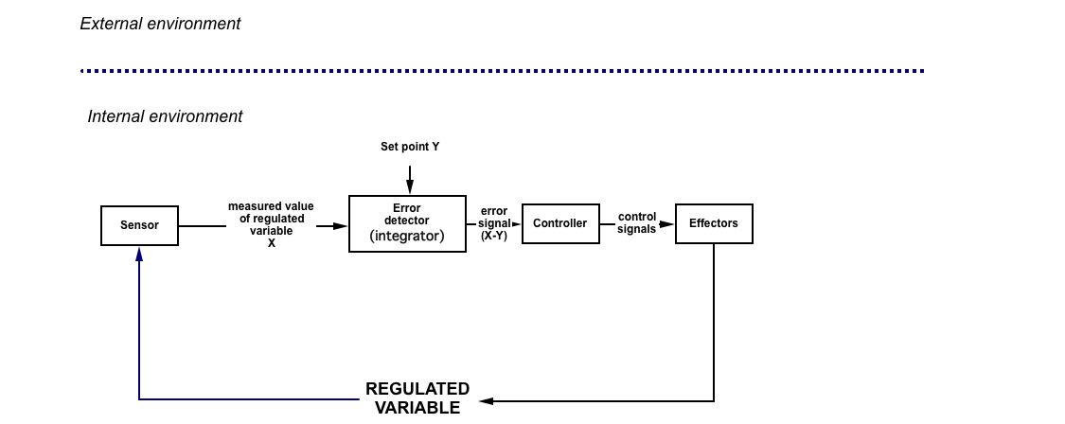
Visual representation of homeostasis

