Slide 1


The core concepts of physiology:
What are they and how do we know if our students understand them?
Joel Michael
Dept. of Physiology
Rush University
Chicago, Illinois
and
The CAP Group
Hobart, 2015

Slide 2
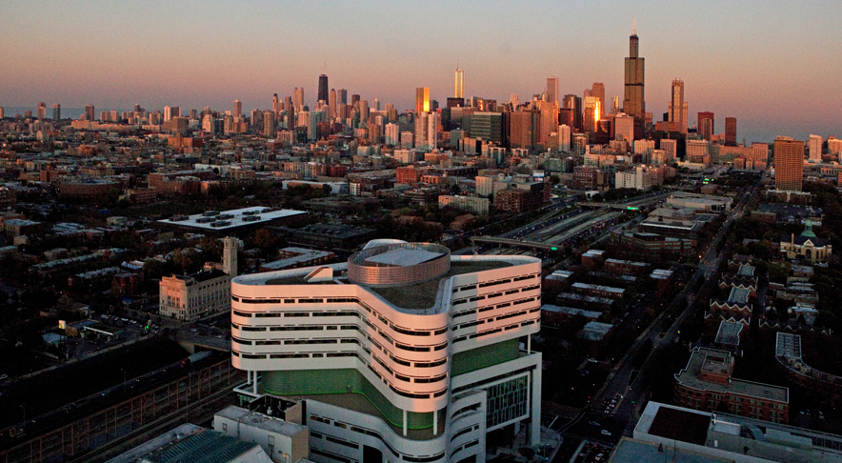
The Medical Center and Chicago
Chicago!
New hospital

Slide 3

The Academic Facility (AcFac)

Slide 4
My agenda today

Slide 5
My agenda today
Who are we and why does it matter?

Slide 6
My agenda today
Who are we and why does it matter?
What are the core concepts of physiology?

Slide 7
My agenda today
Who are we and why does it matter?
What are the core concepts of physiology?
How do we know if our students understand the core concepts?

Slide 8
My agenda today
Who are we and why does it matter?
What are the core concepts of physiology?
How do we know if our students understand the core concepts?
What is the role of the physiology education community in this program?

Slide 9
Who are we?

Slide 10

Who are we?
Members of the CAP team
Bill Cliff, Niagara University (private small university)
Jenny McFarland, Edmonds Community College
Joel Michael, Rush Medical College
Harold Modell, Bastyr University (medical school)
Mary Pat Wenderoth, Univ. of Washington
Ann Wright, Canisius College (small private college)
Supported by NSF grant DUE-1043443.
Notes:
----- Meeting Notes (9/30/14 08:06) -----
bdsfgsdfgsdfgsdfgsfdvnvbxcbxbc

Slide 11
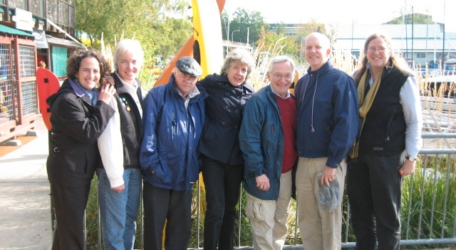
We are the CAP team*
Mary Pat
Jeannie
Harold
Ann
Bill
Jenny
Conceptual Assessment in Physiology

Slide 12

Where our faculty cohort teach(*)
Where CAP members work(@)
@
*
*
*
@
*
*
*
@
*
*
*
*
*
*
*
*
*

Slide 13
The point of this geography lesson
The data we collect comes from educational institutions with highly heterogeneous student populations.
It comes from institutions spanning the entire spectrum in American higher education (community colleges to graduate and medical schools).

Slide 14
What are “core concepts?”

Slide 15
What are core concepts? (1)
By definition, [core concepts] are important and enduring. [Core concepts] are transferable beyond the scope of a particular unit . . . [Core concepts] are the building material of understanding. They can be thought of as the meaningful patterns that enable one to connect the dots of otherwise fragmented knowledge.
Wiggins and McTighe, Understanding by design,
expanded 2nd edition, Arlington, VA:
Association for Supervision and Curriculum Design., 2005, pp. 338-339

Slide 16
What are core concepts?(2)
“Each [core concept] is well tested, validated, and absolutely central to the discipline. Each integrates many different findings and has exceptionally broad explanatory scope. Each is the source of coherence for many key concepts, principles and even other theories in the discipline.”
Duschl, R. A., Schweingruber, H. A. and Shouse, A. W. (Editors). (2007). Taking science to school: Learning and teaching science in grades K-8. Washington, DC: National Academies Press.

Slide 17
My “definition of “core concepts”
For me core concepts are what I want students to remember in five years, even if they have forgotten some or all of the details.

Slide 18
What are the core concepts of physiology?

Slide 19
Conceptual Assessment in Biology
(sponsored by NSF)
Three meetings were held over a three year period.
First meeting brought together 24 biologist from a WIDE variety of disciplines (A-Z almost)
We immediately agreed that before talking about how to do assessment we had to know what we wanted assessed!
So we decided to take as much time as needed to generate a list of core concepts in biology.

Slide 20
Conceptual Assessment in Biology
(sponsored by NSF)
To the surprise and amazement of all of us it took us not more than 1 hour to reach agreement on a list 8 core concepts!
We did acknowledge that different disciplines emphasize different core concepts to a varying extent.
  Physiology emphasizes a slightly different set of concepts than does biochemistry or anatomy.

Slide 21
“Big ideas” in biology (edited)
Living organisms are causal mechanisms . . .
2. The cell is the basic unit of life.
3. Information flow . . . .
Transformations of matter and energy
5. Homeostasis (and “stability”)
6. . . . structure and function . . .
7. Evolution . . . .
8. All life exists [in] an ecosystem . . . .
From 2nd CAB workshop (Michael and McFarland, 2008)

Slide 22
How did we determine the core concepts of physiology?

Slide 23
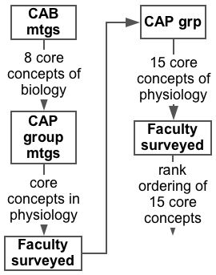

Slide 24
The core concepts of physiology:
Ranking by diverse faculty
Causality (14) Homeostasis (1)
Cell-cell communications (3) Interdependence (4)
Cell membrane (1) Levels of organization (12)
Cell theory (9) Mass balance (13)
Energy (6) Physics/chemistry (10)
Evolution (15) Scientific reasoning (8)
Flow down gradients (5) Structure/function (7)
Genes to proteins (11)
(Michael and McFarland, 2011)

Slide 25
The core concepts of physiology:
Ranking by diverse faculty
Causality (14) Homeostasis (1)
Cell-cell communications (3) Interdependence (4)
Cell membrane (1) Levels of organization (12)
Cell theory (9) Mass balance (13)
Energy (6) Physics/chemistry (10)
Evolution (15) Scientific reasoning (8)
Flow down gradients (5) Structure/function (7)
Genes to proteins (11)
(Michael and McFarland, 2011)

Slide 26
The core concepts of physiology being expanded by CAP
Causality (14) Homeostasis (1)
Cell-cell communications (3) Interdependence (4)
Cell membrane (1) Levels of organization (12)
Cell theory (9) Mass balance (13)
Energy (6) Physics/chemistry (10)
Evolution (15) Scientific reasoning (8)
Flow down gradients (5) Structure/function (7)
Genes to proteins (11)
(Michael and McFarland, 2011)

Slide 27
Homeostasis
The internal environment of the organism is actively maintained constant by the function of cells, tissues, and organs organized in negative feedback systems.
(Michael and McFarland, 2011)

Slide 28
Cell-cell communications
The function of the organism requires that cells pass information to one another to coordinate their activities. These processes include endocrine and neural signaling.
(Michael and McFarland, 2011)

Slide 29
Flow down gradients
The transport of “stuff” (ions, molecules, blood, and air) is a central process at all levels of organization in the organism, and this transport is described by a simple model.
(Michael and McFarland, 2011)

Slide 30
No unique, “correct” set of concepts
A group of biologist decided that “information” was a core concept.
A group of physiologists replaced this with
  Cell-cell communications, and
  Genes to proteins.
Neither is necessarily “right.”
  Which is most useful will depend on your course and your students.

Slide 31
Overlap of core concepts
The 15 core concepts are NOT independent, isolated patterns.
There is significant and important overlap between most of them.
  For example . . .

Slide 32
Homeostasis involves the transmission of information
Cell-cell involves the transmission of information
CELL-CELL
COMMUNICATIONS
HOMEOSTASIS

Slide 33
Teaching/learning physiology
The goal in developing our set of core concepts in physiology was to create a tool for learning with understanding.
  That is to say, our goal was a pragmatic one not an attempt to define the theoretical bases for physiology.

Slide 34
The size of core concepts
Each core concept explicitly and implicitly “contains” many smaller ideas (“items”).
The core concepts vary greatly in “size,” whether we count the number of items or the number of levels.
  Flow down gradients is 20 items and 3 levels
  Homeostasis is 33 items and 2 levels
  Cell-cell communications is 51 items and 4 levels

Slide 35
How do we know if our students understand the core concepts?

Slide 36

How do we get from a core concept to a concept inventory?
*
*An assessment instrument to measure student understand of a core concept

Slide 37
What’s the problem?
Homeostasis, cell-cell communications, and flow down gradients are all, literally, BIG IDEAS.
As such, it is difficult, if not impossible, to directly test a student’s understand of a core concept.
So, we need to determine if they understand the component ideas that make up the core concept.

Slide 38
Unpacking core concepts
We call the process of determining the constituent ideas, the items, that make up a core concept “UNPACKING.”
The results of unpacking a core concept is a conceptual framework.

Slide 39

How do we get from a core concept to a concept inventory?

Slide 40
Unpacking the core concept of homeostasis
It is too large for a PowerPoint slide, so I’ll ask you to look at the handout I have provided as I proceed.

Slide 41
Top level unpacking of the concept of homeostasis
H1. | The organism maintains a more or less stable internal environment.
H2. | A substantial change to a regulated variable will result in a physiological response to restore it toward to its normal range.
H3. | Homeostatic processes require a sensor (“what can’t be measured can’t be regulated”).
H4. | Homeostatic processes require a control center.
H5. | Homeostatic processes require effectors.

Slide 42
Unpacking of component concept of homeostasis
H3. | Homeostatic processes require a sensor (“what can’t be measured can’t be regulated”).
H3.1. | Sensors detect the regulated variable and respond by transducing that stimulus into a different signal.
H3.2. | Sensors respond within a limited range of stimulus values.
H3.3. | Sensors are constantly active (not just active when the regulated variable is not at the set point value or outside of a ‘normal’ range).
H3.4. | An organ system may employ a variety of types of sensors (e.g. chemoreceptors, baroreceptors, mechanoreceptors, etc) to regulate variables associated with that organ system

Slide 43
Developing a conceptual assessment instrument about homeostasis

Slide 44
Developing a conceptual assessment instrument about homeostasis (1)
One cannot directly assess student understanding of homeostasis.
We must assess student understanding of the unpacked, smaller ideas that make up the core concept.
We made a decision to build a concept inventory targeting undergraduate students taking introductory physiology or A&P courses.

Slide 45
Developing a conceptual assessment instrument about homeostasis (2)
We developed questions reflecting our own students’ difficulties with the concept of homeostasis.
We also solicited observed misconceptions from colleagues at national meetings.
We took great care to keep the language accessible to our assumed audience.
The result was a 20 MCQ inventory.

Slide 46
Validating the inventory
We had a cohort of physiology teachers tells us about the importance and degree of difficulty of the questions and modified them accordingly.
We have had 250 students at 7 institutions take the inventory and have concluded a preliminary analysis of their responses.

Slide 47
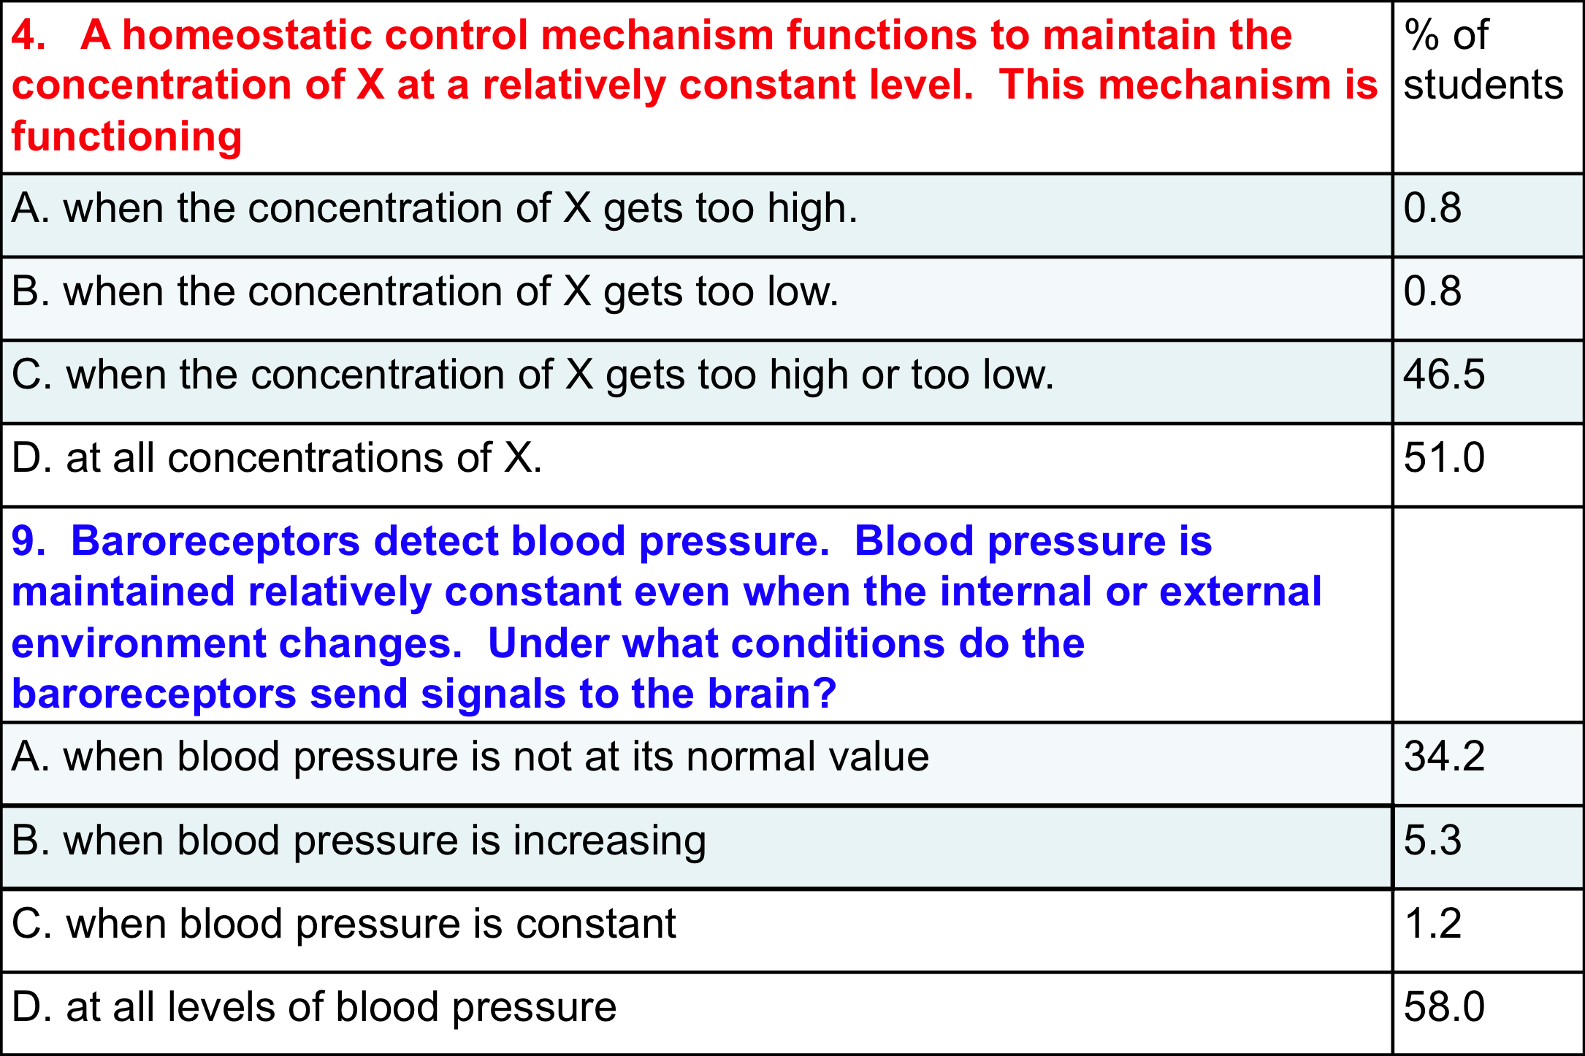
Question types and results
General model
Application

Slide 48
Results of validation studies
Students do better on general model questions than on application questions.
More advanced students do better in general and do not show this difference.
The HCI has no gender bias and no bias in favor of native English speakers.
The degree of difficulty and the discrimination factors demonstrate that the HCI can be used with students at different educational levels.

Slide 49
The HCI is only an example
The set of MCQs we have written and validated are only an example of possible inventories that could be written.
A different inventory might be more appropriate for different students and different courses.

Slide 50
The role of community in our project

Slide 51
The role of community in this enterprise (1)
The conceptual frameworks (unpacking of a core concept) could only be validated with the assistance of a community of physiology teachers.
The validation of a our concept inventory depended on the cooperation of a community of physiology teachers.

Slide 52
The role of community in this enterprise (2)
Reform (change) will require continued building of community so that individual teachers can share their experiences with one another.
Reform ONLY occurs within a community in which every member supports one another!

Slide 53
Concluding remarks
The set of conceptual frameworks of core concepts does NOT constitute a physiology course or curriculum.
The collected set of questions in our concept inventories does not define the learning goals for a physiology course or curriculum.
The core concepts does represent a tool that can be used to facilitate learning with understanding!

Slide 54
To find out more . . .
go to our website
  www.physiologyconcepts.org
  where you will find our papers, abstracts of posters, and eventually samples of our conceptual frameworks and concept inventories.

Slide 55
Thank you for having invited me to attend this meeting in
beautiful Tasmania,
and thank you for your attention!

