Slide 1
Teaching Physiology in the Midst of a Knowledge Explosion:
A Role for Core Concepts
Joel Michael, PhD
Professor Emeritus
Department of Physiology & Biophysics
Rush Medical College
Chicago, IL
jmichael40@gmail.com

Slide 2
Acknowledgements
THE CORE CONCEPTS GROUP
Joel Michael
Jenny McFarland
Harold Modell
Mary Pat Wenderoth
Bill Cliff
Ann Wright
National Science Foundation

Slide 3
My agenda for the morning
“Quantitate” the knowledge explosion
Discuss the universal issue of what to teach and what not to teach
Introduce you to the core concepts of physiology
Discuss how a focus on the core concepts can help minimize the consequences of the knowledge explosion

Slide 4
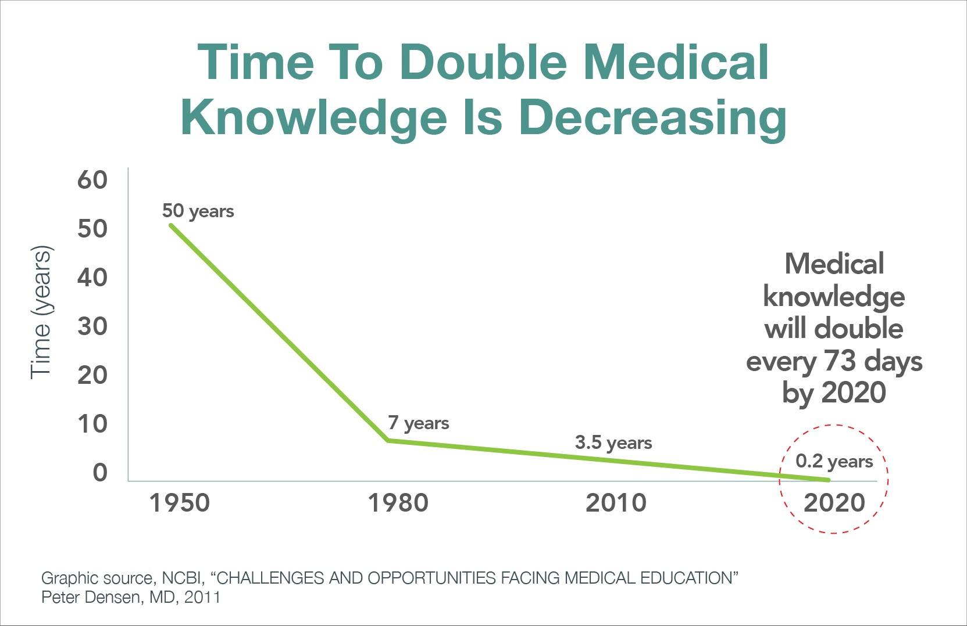
The knowledge explosion (1)
What is being measured?

Slide 5
The knowledge explosion (2)
Some data about the size of physiology textbooks
Human A & P | Saladin (8th), 2018 | 1100+ pp
 | Marieb and Hoehn, 2018 | ≈1200 pp
 | Nath & Martini, 2018 | 1270 pp
Undergrad Physio | Sherwood, 2016 | 800 pp
 | Silverthorn, 2016 | 1168 pp
Medical Physio | Boron and Boulpaep, 2017 | 1441 pp
 | Berne et al, 2018 | 880 pp
 | Guyton and Hall, 2017 | 1250 pp
Average = 1100+ pages!

Slide 6
In light of the knowledge explosion
It is clear that students cannot learn everything that is known about physiology!
It follows that we must answer the question “what should we teach?”
We must also consider how to make it easier for our students to learn.

Slide 7
My thesis is that . . .
a focus on the core concepts of physiology will
  help you make decisions about what is important for your students to learn and what isn’t important, and
  help students learn the necessary physiology better and more “efficiently.”

Slide 8
What should we teach?
This is, of course, a perennial question that we ask whenever we are planning a course.
The answer always depends on the specific course you are teaching, the curriculum of which your course is a part, and the needs of the students taking this course.

Slide 9
How do we decide what to teach?
Teach what you taught last year?
Teach what your predecessor taught?
Teach what your teacher taught?
I suspect that at some point in our career each of us has adopted one or more of these tactics for making a decision.

Slide 10
How do we decide what to teach?
Arthur J. Vander (1998)
SOME DIFFICULT TOPICS TO TEACH (AND NOT TO TEACH) IN RENAL PHYSIOLOGY
Advan Physiol Educ 20(1), S148 – S156

Slide 11
How do we decide what to teach?
In commented on the problem of what to teach, or not teach, Vander said this:
“This is in keeping with one of my major teaching rules—you should never lie but you don’t need to tell the entire truth.” (emphasis added)

Slide 12
More words of wisdom
“. . . that we present the material in layers, the first layer being the absolutely essential primary inputs . . . as we add more layers we should keep referring back to the primary inputs and the bottom line.”
I will have more to say about “layers” in a few minutes.

Slide 13
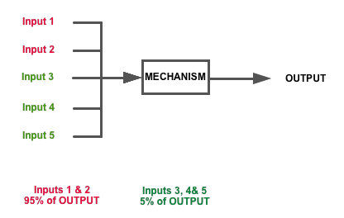
What do they need to know?

Slide 14
What do they need to know?
Do they need to know about
Inputs 3, 4 & 5?

Slide 15
What is a core concept?
[A core concept is an idea that is] “well tested, validated, and absolutely central to the discipline. Each integrates many different findings and has exceptionally broad explanatory scope. Each is the source of coherence for many key concepts, principles, and even other theories in the discipline.”
Duschl RA, Schweingruber HA, Shouse AW (eds). Taking science to school: Learning and teaching science in grades K-8. National Academies Press, Washington DC

Slide 16
For me personally . . .
a core concept is what I want my students to remember in five years even if they remember none of the details!

Slide 17
The 15 core concepts of physiology
(in alphabetical order)
Causality | Homeostasis
Cell-cell communication | Interdependence
Cell membrane | Levels of organization
Cell theory | Mass balance
Energy | Physics/chemistry
Evolution | Scientific reasoning
Flow down gradients | Structure/function
Genes to proteins

Slide 18
The core concepts . . .
are NOT an attempt to systematically define the science of physiology.
DO NOT define the content of a physiology course.
DO NOT define the content of a physiology curriculum.

Slide 19
The core concepts . . .
Are meant to be useful; we wanted to produce something that will help teachers and students.
Therefore our list of core concepts is not unique and not definitive.
• Different teachers, different courses, different curricula may find different core concepts useful.

Slide 20
The core concepts . . .
are a tool that faculty can use in designing and teaching a physiology course.
are a tool which faculty can use in designing a curriculum.
are, not incidentally, a tool to be used by students in their attempt to master physiology.

Slide 21
Core concepts are general models
In 2000 my colleague Harold Modell published a paper
“How to help students understand physiology? Emphasize general models”
Adv Physiol Educ 23: 101-107.
His general models overlap with the core concepts I have been discussing.

Slide 22
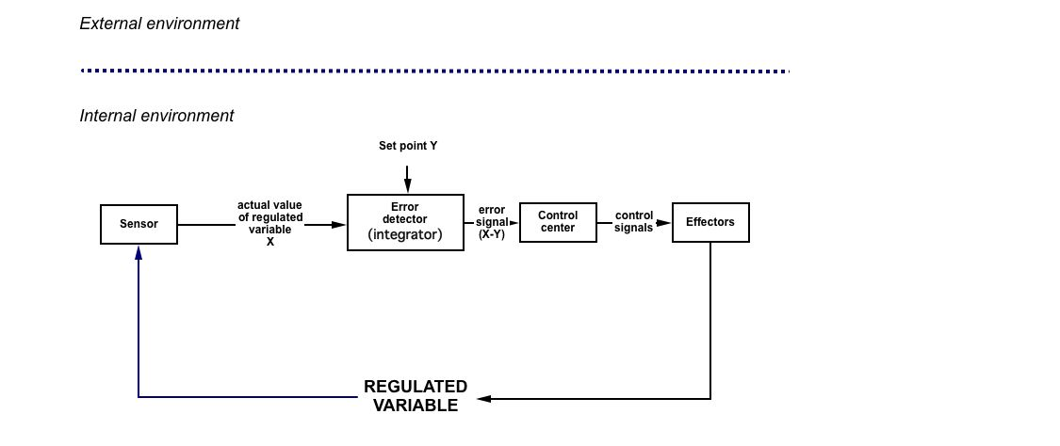
Here’s a model for homeostasis

Slide 23
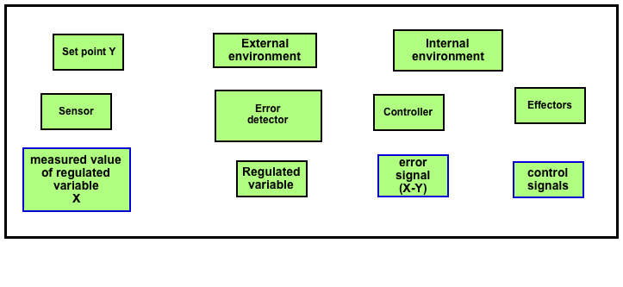
Core concepts are BIG!
These are the “component ideas” that make up the core concept of homeostasis.

Slide 24
Core concepts are BIG!
Understanding a core concept requires the user to understand all of the component ideas that make up the core concept.
Thus, it is essential that we systematically “unpack” a core concept to explicitly reveal its component parts.
The product of “unpacking” is a conceptual framework (CF).

Slide 25
CF for cell membrane
CM2: The cell membrane participates in a variety of mechanisms that maintain the integrity of cells . . . . . .
CM2.1 . . . . . . . .
CM2.2 The cell membrane helps to determine solute concentrations inside the cell . . . . . .
  CM2.2.1 . . . . .. . .
  CM2.2.2 Water and water-soluble substances (ions, most organic molecules) can only cross the membrane via mechanisms . . . . . .
      CM2.2.2.1 Water and some ions traverse the membrane by passive diffusion down . . . . .
6 components of a CF made up of 27 items

Slide 26
Core concepts and the info explosion
In organizing and planning our courses, a focus on the core concepts of physiology may provide at least a partial solution to the problem of students learning all they need to learn in the limited time available to them.
It provides teachers a way to make decisions about what to teach and what not to teach.
It offers students tools to make their learning “more efficient.”

Slide 27
What should they know (1)?
What do (or did) I want my students, first year med students, to remember five years after they took my class?
I want them to remember homeostasis, the general process that regulates the state of the internal environment.
It probably doesn’t matter if they remember the details about the difference between carotid and the aortic baroreceptors.

Slide 28
What should they know (2)?
I want them to remember the cell-cell communications mechanisms present in endocrine and neural systems,
even if they don’t remember of the details of the second messenger pathways activated by epinephrine.

Slide 29
What are the details?
How would I define, if only for myself, what details the students don’t need to remember?
Art Vander talked about “layers” of knowledge and I think that a conceptual framework can reveal the layers in a very explicit way.

Slide 30
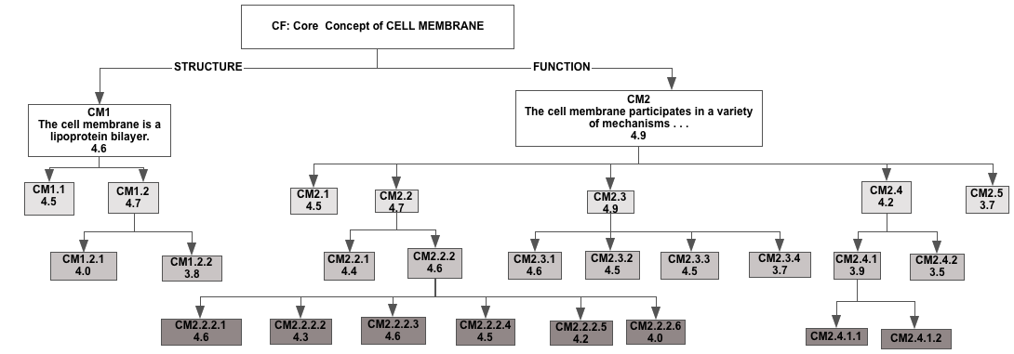
What should they know?
Introductory course

Slide 31
What should they know?
Intermediate course

Slide 32
What should they know?
Advanced course

Slide 33
What should they know?
Advanced course

Slide 34
For physiology teachers
The core concepts, and their conceptual frameworks (CFs), provide an explicit description of general models with wide applicability across all of physiology.
The conceptual frameworks therefore make possible considered decisions about what to teach, and what not to teach, in a particular course.

Slide 35
For students in physiology
The core concepts are tools with which to build, or rebuild, models for specific mechanisms not yet learned or already forgotten.
The conceptual frameworks can function as checklists to keep track of what has already been mastered and what needs to be mastered.

Slide 36
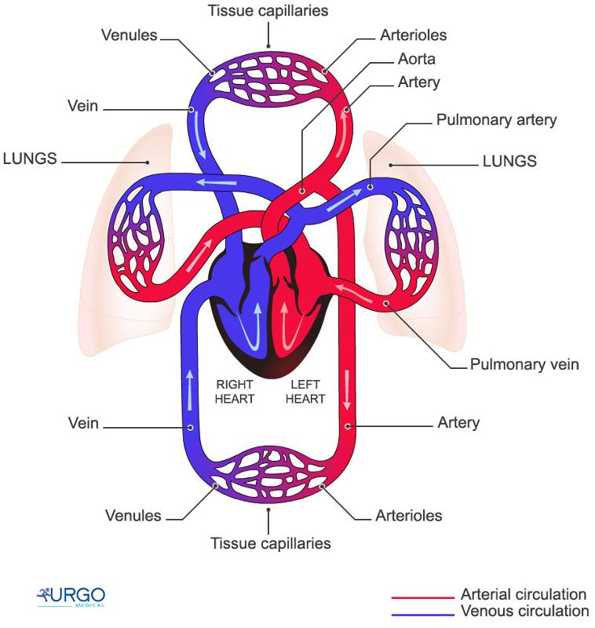
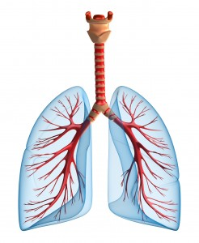
A common experience?
4 weeks later
Blood flow
Air flow
Mastered hemodynamics

Slide 37
A common experience?
≈
Blood flow
Air flow
Mastered hemodynamics
Struggled to understand air flow
Failure to TRANSFER learning

Slide 38
Facilitating learning
When students are able to use core concepts or general models they are able to apply things they already know to the task of learning something that appears new.
Teachers spend less time helping students learn new stuff. Students spend less time learning new stuff, leaving them more time for important details.

Slide 39
My proposal
As you struggle to insure that everything your students need to know is included in your course, THINK ABOUT CORE CONCEPTS OR GENERAL MODELS!
Plan to help your students learn the core concepts and give them practice recognizing where they are applicable.
Give them practice using core concepts as they learn.

Slide 40
How do we do this?
Let’s start by mapping one of the the most important core concepts onto the contents of a typical physiology course (as described by the TOC of a textbook).

Slide 41
Which core concepts to use?
 | Flow | Homeostasis | Cell-Cell | Cell membr | Mass bal
Cell physio
Cell membr
Neuronal
CNS/PNS/ANS
Muscle
Blood
CV
Resp
Renal
Acid/Base
GI
Endo
Reprod
I’ve picked what my colleagues and I more or less agree are the five most important (or most applicable) in a typical physiology course.
This list of physiology topics came from the table of contents of a number of the textbooks on my bookshelf. It is not meant to be prescriptive.

Slide 42
Which core concept to use and where does it apply?
I am going to do this exercise using the most widely applicable core concept of physiology, flow down gradients.

Slide 43
Which core concepts to use?
 | Flow | Homeostasis | Cell-Cell | Cell membr | Mass bal
Cell physio | ✔
Cell membr | ✔
Neuronal | ✔
CNS/PNS/ANS
Muscle | ✔
Blood
CV | ✔
Resp | ✔
Renal | ✔
Acid/Base
GI | ✔
Endo | ✔
Reprod | ✔
I would suggest that flow down gradients applies to all of the topics that have been checked (one could make the case that it actually applies everywhere).

Slide 44
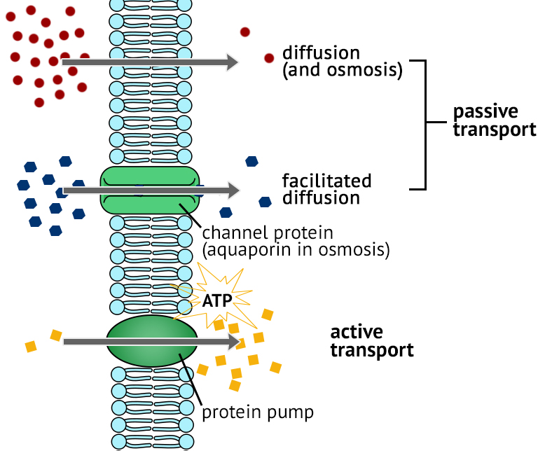
Flow down gradients: A lesson plan
Ion/molecule flow
Air flow
Blood flow

Slide 45
For transfer for occur
Initial learning must occur
Some level of abstraction of that knowledge is needed (ie, core concepts or general models)
Transfer is an active process and thus does not occur passively
How People Learn, Bransford et al.

Slide 46
Why is it hard to generalize?
Why doesn’t an understanding of ion and molecule movement across membranes help students understand why blood flows in the circulation or air flows in the airways?

Slide 47
One reason it is hard to generalize
Fick’s 1st Law of Diffusion
  J = (DA/Δx)ΔC
Poiseuille’s Law
Q=(πr⁴/8ηl)(P_{i} – P_{o})
Airflow in airways
V(dot) = P(πr⁴/8ηl)
From
Berne & Levy Physiology, 6th Edition,
Koeppen and Stanton, 2008

Slide 48
One reason it is hard to generalize
Fick’s 1st Law of Diffusion
  J = (DA/Δx)ΔC
Poiseuille’s Law
Q=(πr⁴/8ηl)(P_{i} – P_{o})
Airflow in airways
V(dot) = P(πr⁴/8ηl)
Flow
Resistance to flow
Energy gradient
From
Berne & Levy Physiology, 6th Edition,
Koeppen and Stanton, 2008
FLOW DOWN GRADIENTS!
Flow = Energy grad/Resistance

Slide 49
A “lesson plan” for flow
It’s intent is to help students understand the core concept/general model of flow down gradients, and develop the ability to use it as a tool for learning physiology.
The plan is “fictitious” in that it’s not a part of a real course.
It’s very much a work in progress.

Slide 50
Flow down gradients: A lesson plan
Fick’s 1st Law of Diffusion:
J = (DA/Δx)ΔC
Where:
J is the flux (flow)
(DA/Δx) are the variables that determine opposition (resistance) to flow
ΔC is the concentration (energy) gradient
Ion/molecule flow

Slide 51
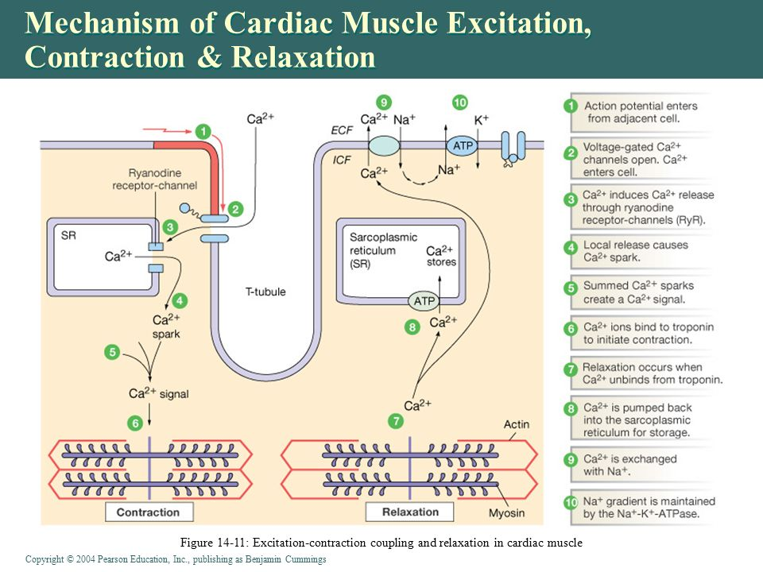
Flow down gradients: A lesson plan
Na⁺ and Ca²⁺ ions move across the sarcolemma and the SR.
QUESTION: What causes these ions to move?
ANSWER: Flow down gradients!
QUESTION: What causes the gradients to be present?
E-C coupling in skeletal muscle

Slide 52
Flow down gradients: A lesson plan
Fick’s 1st Law of Diffusion (passive):
J = (DA/Δx)ΔC
Active transport also occurs (ΔC created by the expenditure of energy)
E-C coupling in skeletal muscle

Slide 53
Flow down gradients: A lesson plan
QUESTION: For flow to occur in the circulation what must be present?
ANSWER: A pressure gradient.
QUESTION: What is the source of the pressure gradient?
ANSWER: Contraction of the heart and elevation of pressure in the aorta.
QUESTION: What is the general model we are dealing with here?
ANSWER: FLOW DOWN GRADIENTS!
Blood flow in the circulation

Slide 54
Flow down gradients: A lesson plan
Poiseuille’s Law
Q=(πr⁴/8ηl)(P_{i} – P_{o})
Determines the flow in any vessel and the flow throughout the entire system.
Blood flow in the circulation

Slide 55
Flow down gradients: A lesson plan
QUESTION: What general model (core concept) do you expect to have to work with here?
ANSWER: FLOW DOWN GRADIENTS
QUESTION: What is the source of the pressure gradient?
Air flow in the airways

Slide 56
Critical features for transfer
Explicit description of the core concept
Opportunities to practice recognizing the applicability of the concept and using it
Consistency in terminology and visual representations

Slide 57
What’s the payoff?
Students understand (can use) the core concepts.
Students can identify where the core concepts are applicable.
Therefore students are not learning each new topic or phenomenon from scratch; they already know something about it.
Students have a general model to which they can add details as they need them.

Slide 58
Some take home messages
We know more than students can or need to learn (the information explosion).
Teachers must decide what their students should learn.
Students need as much help as possible to learn it all.
A focus on the concepts of physiology can help both teachers and students.

Slide 59
Relevant publications
Michael, J., Modell, H., McFarland, J., and Cliff, W. (2009). The “core principles” of physiology: What should students understand? Adv Physiol Educ, 33: 10-15.
Michael, J. and McFarland, J. (2011) The core principles (“big ideas”) of physiology: Results of faculty surveys. Adv Physiol Educ 35: 336-341.
Modell, H., Cliff, W., Michael, J., McFarland, J, Wright, A. ,Wenderoth, M.P. (2015) A physiologist's view of homeostasis. Adv Physiol Educ 39(4): 259-266.
4. McFarland, J, Michael, J., Modell, H., Wenderoth, M.P., Cliff, W., Wright, A. (2016) A conceptual framework for homeostasis: Development and validation. Adv Physiol Educ 40: 213–222.
5. Michael, J, Martinkova, P, McFarland, L, Wright, A, Cliff, W, Modell, H. (2016)
Validating a conceptual framework for the core concept of cell-cell
communication. Adv Physiol Educ 41: 260-265.

Slide 60
Relevant publications
Michael, J, Cliff, W, McFarland, J, Modell, H, Wright, A. (2017) The Core Concepts of Physiology: A New Paradigm for Teaching Physiology. New York: Springer Nature. (Available from APS website)
7. Michael, J and Sircar, A. (2011). Fundamentals of Medical Physiology. New York: Thieme. (Physiology presented in a clinical context and with references to general models/core concepts imbedded throughout the text.)

Slide 61
Check us out at
physiologyconcepts.org
You will find most of our
papers and presentations on
core concepts of physiology there.

