Slide 1
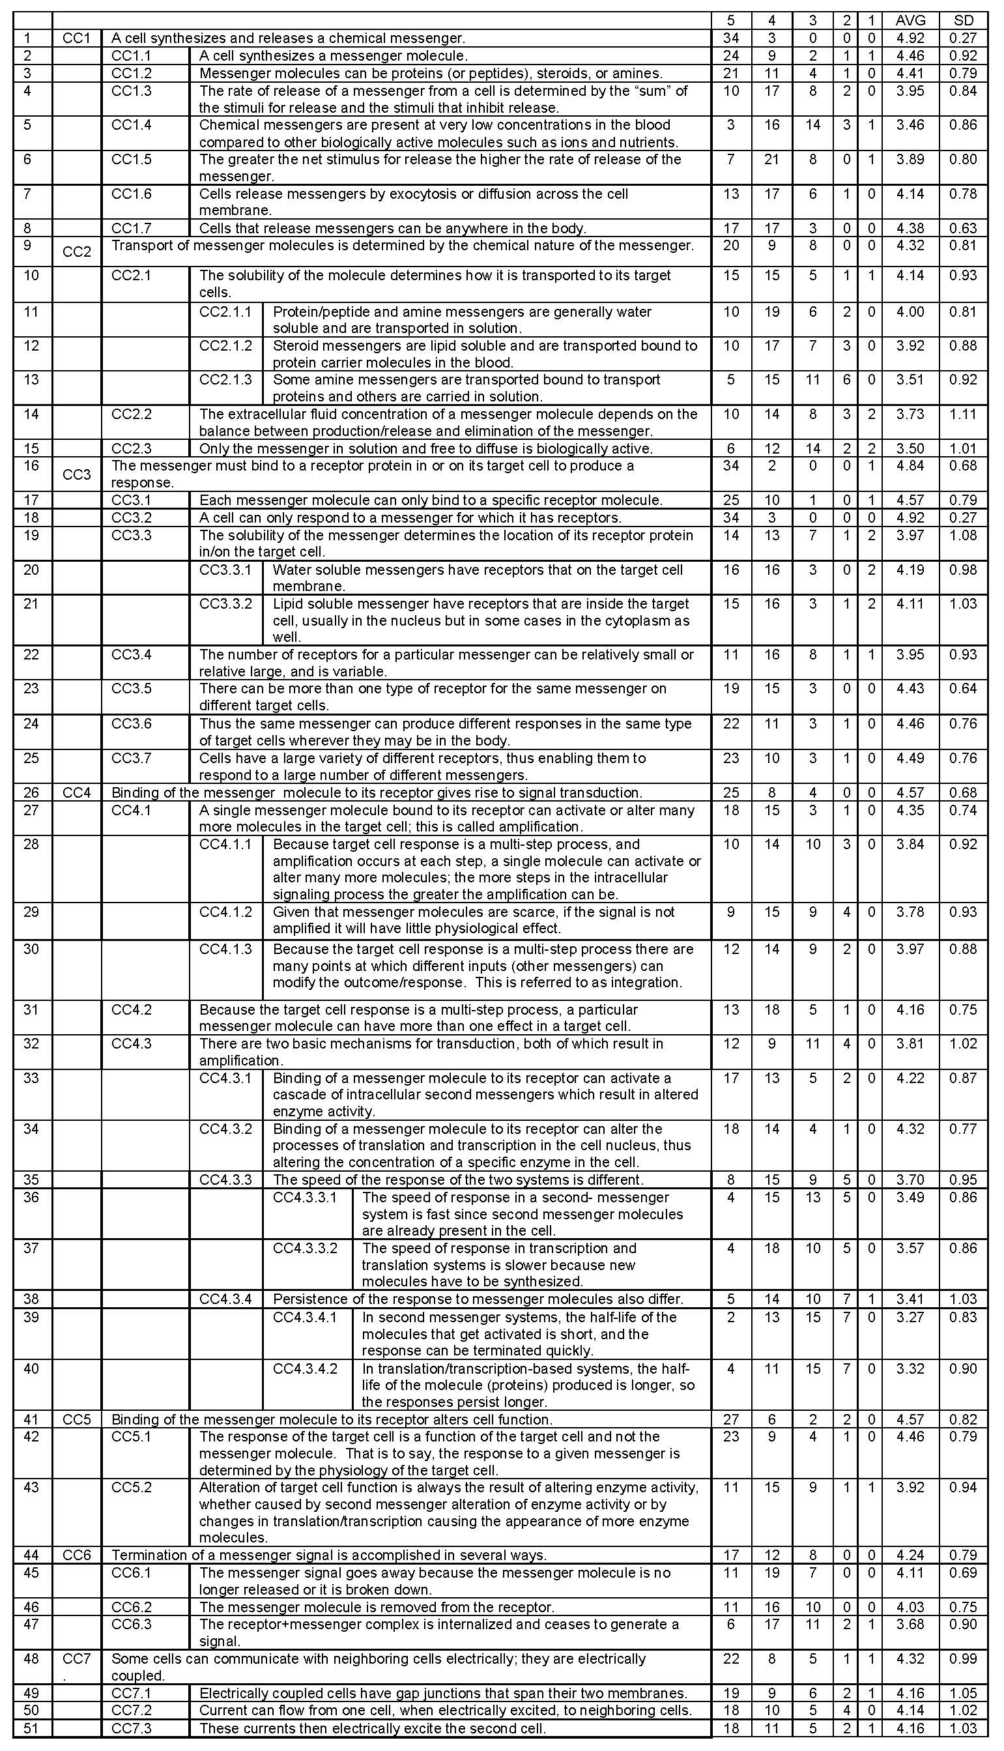
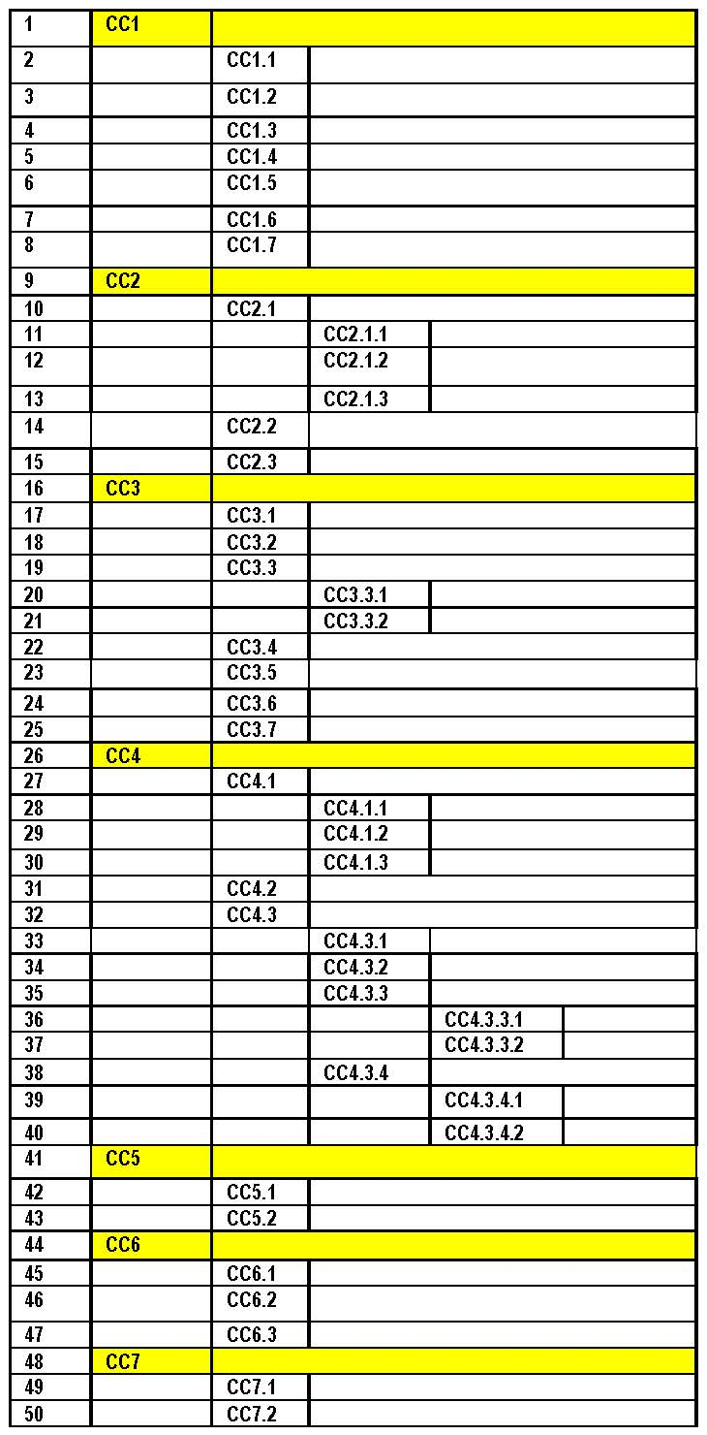
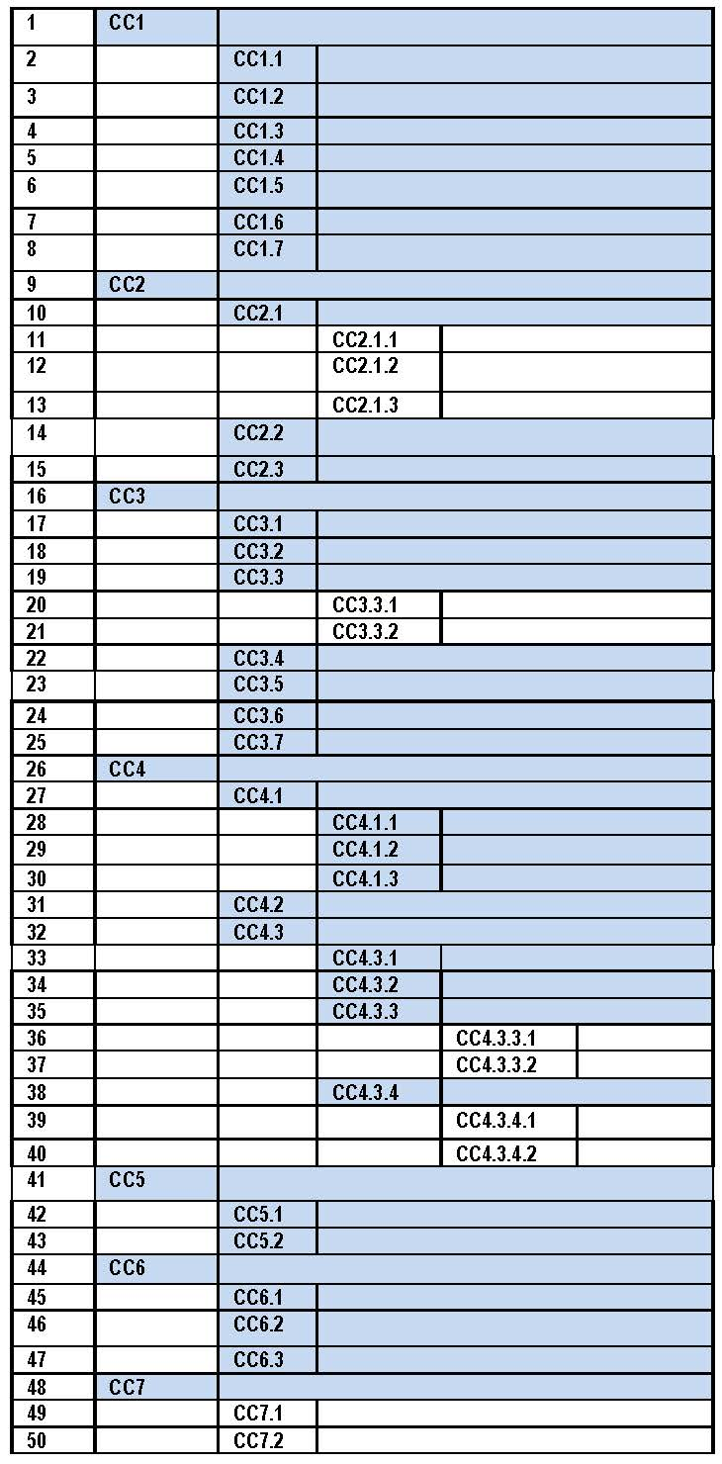
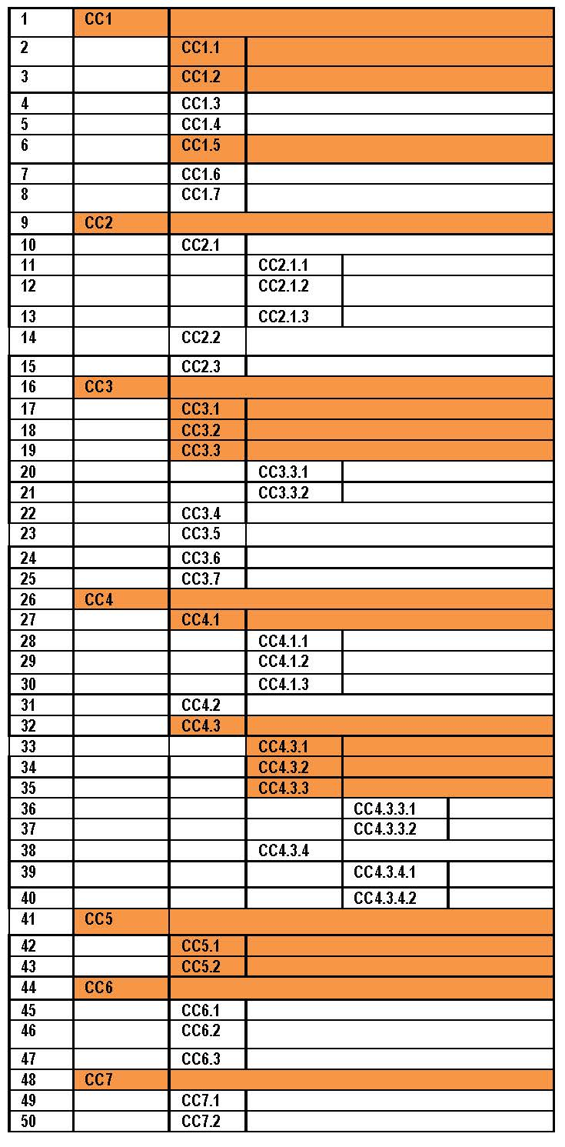
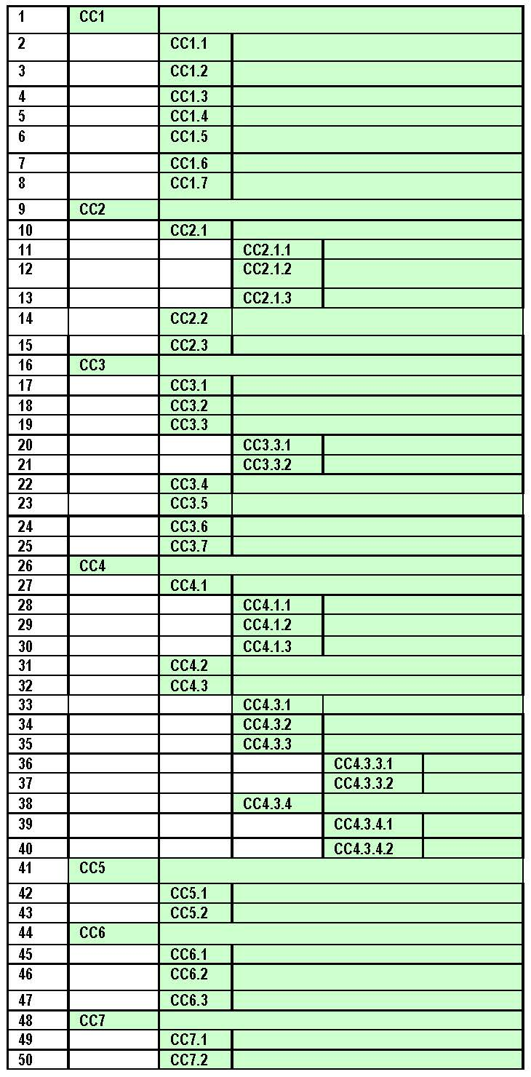

Unpacking the core concept of cell-cell communications for undergraduate or professional level physiology courses
Joel Michael¹, Jenny McFarland², Ann Wright³, Harold Modell⁴, William Cliff⁵
¹Rush Medical College, Chicago, IL, ²Edmonds Community College, Lynnwood, WA, ³Canisius College, Buffalo, NY, ⁴PERC, Seattle, WA, ⁵Niagara University, NY
ABSTRACT
The Cell-Cell Communications Conceptual Framework and ratings from faculty surveys
Using the CC-CF in building a physiology curriculum
What can you do with a conceptual framework?
A conceptual framework (CF) is an “unpacking” of a core concept into its constituent ideas (1). We have published a validated CF for homeostasis (1). More recently we unpacked the core concept of cell-cell communications and validated the CF that resulted (2). The cell-cell communications conceptual framework (CC-CF) is made up of seven critical components and 44 constituent ideas arranged in a hierarchy with as many as three levels. It is large, complex, and encompasses many physiological mechanisms.
The CC-CF is more comprehensive, contains more ideas, than students in a typical undergraduate introductory physiology course are expected to learn. On the other hand, students in a professional level physiology course (medical, dental) might well be expected to learn it all.
This thus raises the question of how to edit (“trim”) the CC-CF (or any CF) to meet the needs of a particular course. In the process of preparing and then validating the homeostasis CF (1) we applied a simple rule: if fewer than 30% of our respondents rated the item as Essential it was dropped from the framework.
The same rule applied to the CC-CF results in 17 items being eliminated, reducing the size and complexity of the CF. However, some of the items eliminated may be deemed important by a particular physiology teacher. An alternative rule would call for elimination of all items at the 4th level in our hierarchy (four items would be removed).
While algorithmic approaches are appropriate for preparing CFs for dissemination to a wide audience, they may not serve the individual teacher well. A CF is, by its very nature, highly structured, and removing items according to some arbitrary rule may create a distorted representation of the core concept. CFs are meant as teaching and learning tools, and such tools must be adapted to the particular needs of the students. Nevertheless, the cell-cell communications conceptual framework offers teachers of physiology at any level a tool that can be customized to meet their needs.
Students are expected to master those items highlighted.
A conceptual framework (CF) such as the one we have presented for cell-cell communications is a teaching and learning tool that can be used in a number of ways.
For physiology teachers:
A CF can help in making explicit the learning objectives for your course.
a CF is the prelude to developing conceptually oriented examination questions or a concept inventory.
a CF can aid in building or revising a curriculum to insure that it encompasses those core concepts deemed essential by the faculty.
For students:
a CF is a powerful learning tool that helps organize the physiological phenomena that are being studying.
A CF is a tool that facilitates the acquisition, retention, and understanding of new physiology ideas.
Introductory A& P
course
Such courses commonly use textbooks by Martini or Marieb. An examination of these books shows that they both cover only the critical components (main ideas - CC1-CC7) and only at a phenomenological level. There is little attempt to describe mechanisms for the phenomena being discussed. The CC-CF for such a course might look like the one on the left. However, there is no explicit description of these phenomena as representing a core concept or general model.
(3) Advanced Physiology course
In this hypothetical advanced course students are required to add to their model more the constituent ideas. The selection of what to add is determined by the overarching goals of the course and the program of which it is a part. Silverthorn’s book could also be used for this course.
(2) Intermediate Physiology course
At the next level students are expected to add an understanding of the selected constituent ideas to their understanding of the critical components. In other words, the students are expected build a more complex model of the core concept. A textbook like Silverthorn can be used as a resource for a course at this level.
(4) First year medical physiology course or graduate course
Commonly used textbooks include Berne and Levy and Boulpaep. An examination of these books reveals that they cover all of the items in the CC-CF seen on the right.
References
McFarland et al., (2016). A conceptual framework for homeostasis: development and validation. Adv Physiol Educ. 40: 213-222.
Michael et al. (2016). A conceptual framework for the core concept of cell-cell communication. FASEB J April 2016 (in press). Poster: eb16-cc-cf-final-02-22.pdf
McFarland et al., (2015). A Homeostasis Concept Inventory for Undergraduate Physiology FASEB J April 2015 29:541.33
http://www.fasebj.org/content/29/1_Supplement/541.33
Modell et al. (2015). A physiologist’s view of homeostasis. Adv Physiol Educ 39: 259-266.
Introduction
The cell-cell communications conceptual framework (CC-CF) is a large, hierarchically organized unpacking of one of the most important core concepts of physiology. Its size and complexity means that it will not meet the needs of all physiology courses.
Here we show how the CC-CF can be edited for different courses and in a way that reflects the critical components and constituent ideas of cell-cell communication expressed in widely used textbooks that are tailored to these courses. The three undergraduate courses show how the CC-CF can be used to create a learning progression that unfolds the concept of cell-cell communication throughout an undergraduate biology or physiology curriculum.
The other conceptual frameworks that we have created (homeostsis and flow down gradients) can be used in the same way.
The ratings for each item (1=Not Important . . . . 5=Essential) were counted and the mean (AVG) and standard deviation (SD) were calculated
The means ranged from 3.46 (between Important and Moderately Important) to 4.92 (slightly less than Essential).
No more than 2 respondents rated any item as Not Important an all items were rated as Essential by at least two respondents.
We conclude that our respondents assessed that the conceptual framework had content validity.
NOTE:
Eliminating items with fewer than 30% Essential ratings results in dropping 21 items (#s 4-6, 11-15, 22, 28, 29, 35-40, 43, 45-47).
Eliminaitng items at the 4th level of the heirarchy would result in 4 items being dropped (36, 37, 39, 49).
Acknowledgement and Contacting the
CAP team
This QR code will take you to our website where you will find our papers, abstracts, pdfs of our posters (including this one), and other materials created by our group.
Four “hypothetical” physiology courses are described. Courses (1), (2) and (3) constitute the sequence for an undergraduate physiology major. The proposed cell-cell components of these courses are intended to be descriptive not prescriptive. Note that expectations of student mastery are cumulative. That is, students in the Intermediate Physiology course are expected have mastered the learning objectives (items in the CF) that they encountered in the Introductory course. That is to say they will be held accountable for their ability to use these ideas in their thinking about physiology mechanisms. Course (4) describes a medical or graduate level course in which students are expected to master all of the elements of the CC-CF. Students at this level are expected to have a fully elaborated model of this core concept.
Supported by NSF grant DUE-1043443

