Slide 1


Using Core Concepts in the Physiology Classroom
Joel Michael, PhD
Dept. of Physiology & Biophysics
Rush Medical College
Chicago, IL

Slide 2
Acknowledgements
The Core Concepts Team
Joel Michael
Jenny McFarland
Harold Modell
Bill Cliff
Mary Pat Wenderoth
The National Science Foundation

Slide 3
My agenda for this afternoon
What is a “core concept?”
How did our project about core concepts evolve?
What are the core concepts of physiology?
How can we use core concepts to facilitate learning?

Slide 4
(1) What is a core concept?
[A core concept is an idea that is] “well tested, validated, and absolutely central to the discipline. Each integrates many different findings and has exceptionally broad explanatory scope. Each is the source of coherence for many key concepts, principles, and even other theories in the discipline.”
Duschl RA, Schweingruber HA, Shouse AW (eds). Taking science to school: Learning and teaching science in grades K-8. National Academies Press, Washington DC

Slide 5
For me personally
a core concept is what I want my students to remember in five years even if they remember none of the details!

Slide 6
What would you nominate as a core concept of physiology?

Slide 7
Some definitions
Core concept: an idea or concept with wide applicability in a domain
Conceptual framework: an explicit definition of all of the component ideas that make up a core concept (big idea); I’ll have more to say about these later.
Concept inventory: an assessment instrument intended to determine whether students understand a core concept.

Slide 8
(2) How did we develop the core concepts of physiology?
CAB meeting – Conceptual Assessment in Biology (Michael, 2007)
Deliberations about core concepts of physiology
(2007-2008; Michael et al, 2009)
Discussions and workshops at EB and HAPS meetings (2007-2010)
Surveys of physiology teaching faculty
(Michael and McFarland, 2011)

Slide 9
The CAB meeting (2007)
NSF sponsored meeting to discuss how to assess students’ conceptual understanding of biology
First we had to agree on the concepts to be assessed
Did so remarkably quickly
Agreed that not every core concept was equally important in the various biology disciplines

Slide 10
BIOLOGY (CAB mtg)
Causality
Ecosystems
Evolution
Homeostasis
Information flow
Matter/energy
Structure/function
The cell
With the exception of ecosystems and evolution, ALL of these core concepts are widely applicable in physiology

Slide 11
Deliberations by project team
Following CAB meeting the team considered generating a list of core concepts that specifically applied to physiology
Goal was to determine concepts so that concept inventories could be written
Results of our deliberations published (Michael et al, 2009)

Slide 12
Discussions with physiology teaching community
Between 2007 and 2010 we had a number of discussions of the core concepts project with colleagues at national meetings.
Although we did not systematically gather feedback, it was clear that the community had somewhat different ideas about core concepts than the ones we had published.

Slide 13
Physiology (Michael etal, 2009)
Causal mechanism
Ecosystems & environment
Evolution
Homeostasis
Information flow
Matter/energy transfer&transform.
Structure/function relationships
The cell
Levels of organization
BIOLOGY (CAB mtg)
Causality
Ecosystems
Evolution
Homeostasis
Information flow
Matter/energy
Structure/function
The cell
We added only one additional core concept although our descriptions of a number of the core concepts are somewhat different than was generated at the CAB meeting.

Slide 14
Survey of physiology teachers
(Michael & McFarland, 2011)
First survey asked respondents to tell us what they thought the core concepts were
Second survey asked them to rank order the importance for their student’ understanding of each of the identified core concepts
Third survey asked them to evaluate the items in the flow down gradients unpacking

Slide 15
(3) The core concepts of physiology
(Michael and McFarland, 2011)
Cell membrane (1) | Cell theory (9)
Homeostasis (1) | Physics/chemistry (10)
Cell-cell communic.(3) | Genes to proteins (11)
Interdependence (4) | Levels of organiz. (12)
Flow down gradients (5) | Mass balance (13)
Energy (6) | Causality (14)
Structure/function (7) | Evolution (15)
Scientific reasoning (8) | Rank ordering

Slide 16
Important to note that . . .
The least important core concept, evolution, received an “average ranking” of 3.3 on a scale where 5=strongly agree about importance and 1=strongly disagree about importance.
Respondents thought that ALL core concepts were of some importance.

Slide 17
Physiology (Michael etal, 2009)
Causal mechanism
Ecosystems & environment
Evolution
Homeostasis
Information flow
Matter/energy transfer&transform.
Structure/function relationships
The cell
Levels of organization
PHYSIOLOGY (Michael & McFarland, 2011)
Causality
Cell theory
Cell-cell communication
Energy
Evolution
Flow down gradients
Genes to proteins
Interdependence
Levels of organization
Mass balance
Scientific reasoning
Structure/function
Cell membrane
Homeostasis
A comparison of the 2009 core concepts and the list generated from responses to our surveys (listed in alphabetic order).
Physics/chemistry

Slide 18
Physiology (Michael etal, 2009)
Causal mechanism
Ecosystems & environment
Evolution
Homeostasis
Information flow
Matter/energy transfer&transform.
Structure/function relationships
The cell
Levels of organization
PHYSIOLOGY (Michael & McFarland, 2011)
Causality
Cell theory
Cell-cell communication
Energy
Evolution
Flow down gradients
Genes to proteins
Interdependence
Levels of organization
Mass balance
Scientific reasoning
Structure/function
Cell membrane
Homeostasis
Our original core concept of information was replaced by cell-cell and genes to proteins
Physics/chemistry

Slide 19
Physiology (Michael etal, 2009)
Causal mechanism
Ecosystems & environment
Evolution
Homeostasis
Information flow
Matter/energy transfer&transform.
Structure/function relationships
The cell
Levels of organization
PHYSIOLOGY (Michael & McFarland, 2011)
Causality
Cell theory
Cell-cell communication
Energy
Evolution
Flow down gradients
Genes to proteins
Interdependence
Levels of organization
Mass balance
Scientific reasoning
Structure/function
Cell membrane
Homeostasis
The original core concept the cell was replaced by cell membrane and cell theory
Physics/chemistry

Slide 20
“Properties” of core concepts
Core concepts vary in “size” (flow down gradients is small while evolution is very large)
Core concepts are NOT independent of one another (cell, cell-cell communication, and flow for example)
Flow and mass balance are “universal,” applying to the physical and biologic systems

Slide 21
Core concepts ARE NOT . . .
attempts to define the SCIENCE OF PHYSIOLOGY.
meant to define the CONTENT OF A PHYSIOLOGY COURSE.
meant to define the CONTENTS OF A PHYSIOLOGY CURRICULUM.

Slide 22
The core concepts are NOT . . .
to be engraved in stone!
You may come up with a different list for your class. I may change my list because something has been left out or not stated in a way that is useful for my students.
This list is a work in progress!

Slide 23
Core concepts ARE . . .
tools meant to be used by teachers and their students to facilitate meaningful learning (learning with understanding).

Slide 24
Definition of two core concepts we will be focusing on today
Cell-cell communications: The function of the organism requires that cells pass information to one another to coordinate their activities. These communications processes include endocrine and neural signaling. This concept describes the mechanism by which cells pass information to one another, thus making possible the coordinated activity of all of the cells of the body.
Flow down gradients: The transport of “stuff” (ions, molecules, blood, and gas) is a central process at all levels of organization in the organism, and a simple model describes such transport. Ions crossing a cell membrane, blood flowing in blood vessels, gas moving in airways, and chyme moving down the gastrointestinal tract are all processes that result from the interaction of an energy gradient and the resistance to flow that is present.

Slide 25
Core concepts are . . .
by definition BIG ideas.
This means that they are widely applicable in the domain.
This also means that they are made up of many smaller ideas or concepts.
We are in the process of developing explicit statements of these sub-ideas for our core concepts.

Slide 26
What is a conceptual framework?
A conceptual framework is the result of “unpacking” a core concept of all of the smaller ideas that make it up.
It is not intended as a description of the content of a course or a section of the course. It is a tool that can be used in a variety of ways to facilitate student learning.

Slide 27
What does a conceptual framework look like?
Level | Example
CORE CONCEPT (BIG IDEA) | CELL-CELL COMMUNICATION
Critical components | CC4 binding of the messenger molecule to its receptor gives rise to signal transduction
Constituent ideas | CC4.3 there are two basic mechanisms for transduction . . .
Elaborations | CC4.3.3 The speed of response of the two systems is different
Amplifications | CC4.3.3.1 The speed of response in a second messenger system is fast

Slide 28
(4) How can you use core concepts to facilitate student learning??
An understanding of the core concepts will help students better understand physiology.
Today there is one specific use for core concepts that I want to focus on for the rest of my talk.

Slide 29
A Common Problem for Learners
Learners tend to compartmentalize what they learn.
Transfer of learning (the “opposite” of compartmentalization) is hard to do.
Teachers do a poor job of helping students learn to transfer.

Slide 30
One example of failure to transfer
Students learn about chemical equilibrium (Le Chatelier’s principle) in an undergrad chemistry course
H₂O + CO₂ H₂CO₃ H⁺ + HO₃⁻
When they encounter the very same equation in considering acid/base balance many of them are unable to apply this idea in a physiology course context.

Slide 31
Another example in my classroom
Students learn hemodynamics in CV block
Four weeks later they encounter air flow in the airways in the respiratory block
  They behave as though they had never encountered the phenomenon of flow down a gradient
The same relationships apply in both the CV and the respiratory systems although the “labels” are different.

Slide 32
Why does this matter?
Faculty spend time and effort helping students learn something that they should actually already understand.
Students spend time and effort relearning things they should already know and understand.
Time and effort are scarce commodities for both faculty and students!

Slide 33
What can we do about this?
If there has been some focus on the relevant core concepts, and if students have learned to recognize where they are applicable, it should reduce the need for relearning things.
I want to briefly look at two examples of how this change might be accomplished.

Slide 34
Core Concept:
Flow down gradients
Flow down gradients: The transport of “stuff” (ions, molecules, blood, and gas) is a central process at all levels of organization in the organism, and a simple model describes such transport. Ions crossing a cell membrane, blood flowing in blood vessels, gas moving in airways, and chyme moving down the gastrointestinal tract are all processes that result from the interaction of an energy gradient and the resistance to flow that is present.

Slide 35
Flow down gradients
Hemodynamics
Flow = (P₁ – P₂)/Resistance to Flow
where
(P₁ –P₂) represents any energy gradient
and
Flow is the “movement” of blood in the circulation or air in the airways

Slide 36
Flow down gradients
Diffusion
J_{X} = P_{X} ([X]_{o} – [X]_{i})
where
J_{X} is the flux (of molecules, ions etc),
P_{X} is the permeability coefficient
(a measure of the resistance to flow),
and
([X]_{o} – [X]_{i}) represents to energy gradient

Slide 37
Flow down gradients
Movement of most “things” across the cell membrane
Blood flow in the circulatory system
Air flow in the airways
Movement of filtrate down the nephron
Etc!
All of these phenomena are described by the same relationship! The same core concept.

Slide 38
Core concept:
Cell-cell communications
Cell-cell communications: The function of the organism requires that cells pass information to one another to coordinate their activities. These communications processes include endocrine and neural signaling. This concept describes the mechanism by which cells pass information to one another, thus making possible the coordinated activity of all of the cells of the body.

Slide 39
Cell-cell communication (1)
One cell produces a signal (electrical, messenger molecule) under certain conditions.
That signal reaches another cell and stimulates a response. That response is an alteration of the function of the second cell.

Slide 40
Cell-cell communication (2)
Synaptic and neuromuscular transmission
Central nervous system
Action of the ANS on the heart
GI system
Control of respiratory muscles
Endocrine system
Signals in all of these systems can be either electrical or chemical.

Slide 41
Cell-cell communication (3)
The commonality of these mechanisms is usually obscured by differences in terminology, differences in visual representations, and by the differences in tissues and organs that are being described.
However, if students understand the core concept of cell-cell communications they are more likely to see the similarities.

Slide 42
How to promote transfer (1)
Successful transfer requires the recognition that situation (mechanism) 1 is fundamentally the same as situation (mechanism) 2.
In the physiology classroom, transfer can be increased if students recognize the core concepts, and can use them wherever they are applicable.

Slide 43
How to promote transfer (2)
So, how do you help your students acquire this ability?

Slide 44
How to promote transfer (2)
So, how do you help your students acquire this ability?
Demonstrate it for your students.

Slide 45
How to promote transfer (2)
So, how do you help your students acquire this ability?
(1) Demonstrate it for your students.
The transferability of a concept to a wide variety of systems will not be obvious to your students. Thus, you must show them how a particular core concept can be used to help understand seemingly different phenomena.

Slide 46
How to promote transfer (2)
So, how do you help your students acquire this ability?
(1) Demonstrate it for your students.
(2) Have them practice it as the course proceeds.

Slide 47
How to promote transfer (2)
So, how do you help your students acquire this ability?
Demonstrate it for your students.
Have them practice it as the course proceeds.
If they are to develop the skill of recognizing where a core concept applies, you have to provide them with multiple opportunities to practice this skill.

Slide 48
How to promote transfer (2)
So, how do you help your students acquire this ability?
(1) Demonstrate it for your students.
(2) Have them practice it as the course proceeds.
(3) Require them to do it.

Slide 49
How to promote transfer (2)
So, how do you help your students acquire this ability?
(1) Demonstrate it for your students.
(2) Have them practice it as the course proceeds.
(3) Require them to do it.
It must be part of your learning objectives and you must test them on their ability to do it.

Slide 50
How to promote transfer (2)
So, how do you help your students acquire this ability?
(1) Demonstrate it for your students.
(2) Have them practice it as the course proceeds.
(3) Require them to do it.

Slide 51
How to promote transfer (3)
For the preceding “prescription” to work the following conditions must be present in your course:

Slide 52
How to promote transfer (3)
For the preceding “prescription” to work the following conditions must be present in your course:
(1) The issue must be explicitly addressed

Slide 53
How to promote transfer (3)
For the preceding “prescription” to work the following conditions must be present in your course:
The issue must be explicitly addressed
We all have a tendency to assume that people, our students, understand what we understand. But this is NOT necessarily true and we therefore have to explicitly have a conversation about core concepts

Slide 54
How to promote transfer (3)
For the preceding “prescription” to work the following conditions must be present in your course:
(1) The issue must be explicitly addressed
Repetition is required

Slide 55
How to promote transfer (3)
For the preceding “prescription” to work the following conditions must be present in your course:
(1) The issue must be explicitly addressed
Repetition is required
It is not enough to assign the chapter on homeostasis at the front of the book. You must use the core concept wherever it applies.

Slide 56
How to promote transfer (3)
For this “prescription” to work the following conditions must be present in your course:
(1) The issue must be explicitly addressed
Repetition is required
Consistency in all things is required

Slide 57
How to promote transfer (3)
For this “prescription” to work the following conditions must be present in your course:
(1) The issue must be explicitly addressed
Repetition is required
Consistency in all things is required
You should use the same terminology and visual representations whenever you talk about a particular core concept.

Slide 58
How to promote transfer (3)
For this “prescription” to work the following conditions must be present in your course:
(1) The issue must be explicitly addressed
Repetition is required
(3) Consistency in all things is required

Slide 59
A much fuller description of how to implpement our prescription for facilitating transfer and using core concepts in teaching physiology can be found in our book
The Core Concepts of Physiology:
A New Paradigm for Teaching Physiology

Slide 60
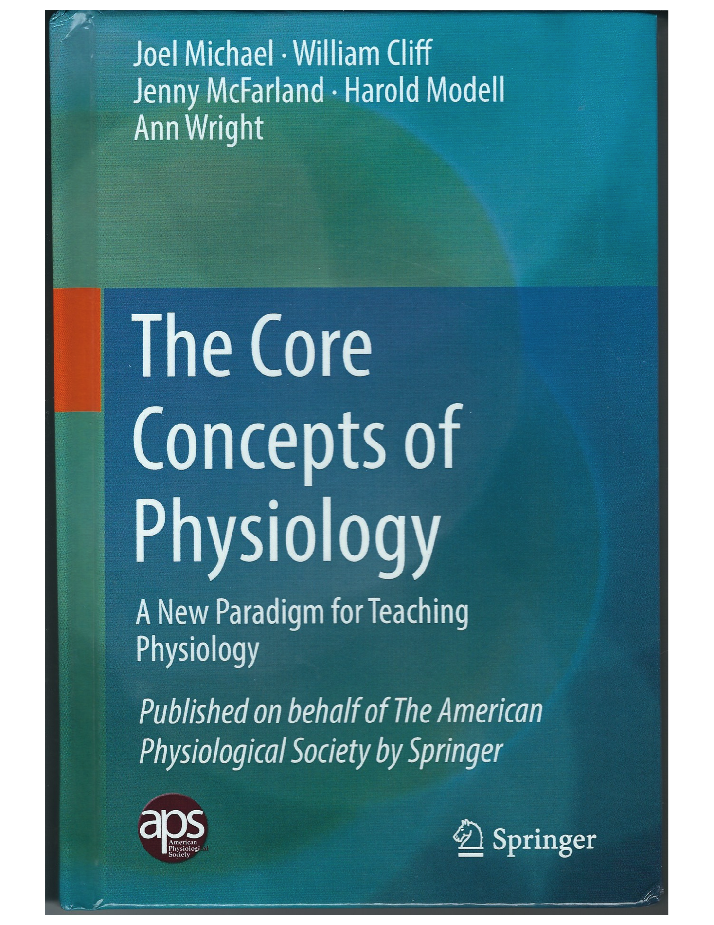
If you are a member of APS you can download it at no cost from the Springer website. Otherwise it is available for purchase of either an electronic version or as an actual print on paper book.

Slide 61
If you are a member of APS you can download it at no cost from the Springer website. Otherwise it is available for purchase of either an electronic version or as an actual print on paper book.
We, the authors, get NO royalties for the sale of the book!

Slide 62
We have published our core concepts.
We have also validated and published conceptual frameworks for three of the core concepts.
We have published several papers describing the development of a concept inventory for homeostasis.
You can find our papers at:
physiologyconcepts.org

Slide 63
There is obviously a great deal more work to be done in order to fully implement a core concepts approach to teaching physiology.
We are presently working to validate our conceptual framework for cell membrane.
If you be willing to help, go to
physiologyconcepts.org

Slide 64
If anyone has a possible interested in getting involved with this effort, get in touch. I personally am willing to help in any way possible.

Slide 65
THANK YOU FOR YOUR ATTENTION!
If there are any questions I think we have time for some answers.

Slide 66
Journal References
1. Michael, J., Modell, H., McFarland, J., and Cliff, W. (2009). The “core principles” of physiology: What should students understand? Adv Physiol Educ, 33: 10-15.
2. Michael, J. and McFarland, J. (2011) The core principles (“big ideas”) of physiology: Results of faculty surveys. Adv Physiol Educ 25: 336-3413.
3. Modell, H., Cliff, W., Michael, J., McFarland, J, Wright A. , Wenderoth, M.P. (2015) A physiologist's view of homeostasis. Adv Physiol Educ 39(4): 259-266.
4. McFarland, J, Michael, J., Modell, H., Wenderoth, M.P., Cliff, W., Wright, A. (2016) A conceptual framework for homeostasis: Development and validation. Adv Physiol Educ 40: 213–222.

Slide 67
5. McFarland, JL, Price, RM, Wenderoth, MP, Martinková, P, Cliff, W, Michael, J, Modell, H, Wright, A. (2016). Development and validation of the homeostasis concept inventory. CBE-Life Sci Educ 16: ar35.
6. Michael, J, Martinkova, P, McFarland, L, Wright, A, Cliff, W, Modell, H. (2017). Validating a conceptual framework for the core concept of cell-cell communication. Adv Physiol Educ 41: 260-265.
7. Michael et al. (2017). The core concepts of physiology: A new paradigm for teaching physiology. New York: Springer Nature (free download to APS members).

Slide 68
The core concepts we are continuing to focus on
Cell membrane (1) | Cell theory (9)
Homeostasis (1) | Physics/chemistry (10)
Cell-cell communic.(3) | Genes to proteins (11)
Interdependence (4) | Levels of organiz. (12)
Flow down gradients (5) | Mass balance (13)
Energy (6) | Causality (14)
Structure/function (7) | Evolution (15)
Scientific reasoning (8) | Published | In progress

